Slide 1
Citi Bike Data Analysis
By Elias Mengesha
Last updated April 10, 2023

Slide 2
Project Goal:
To better understand the behavior of Citi Bike’s customer base (both one-time users and subscribers) and how they use Citi Bikes
This will help us to:
Identify where more bikes should be installed
Create targeted marketing campaigns that will appeal to different customer segments

Slide 3
Key questions:
What are the most popular pick-up locations across the city for Citi Bike rental?
How does the average trip duration vary across different age groups?
Which age group rents the most bikes?
How does bike rental vary across the two user groups (one-time users vs long-term subscribers) on different days of the week?
Does the factor of user age impact the bike trip duration?

Slide 4
Findings & Insights

Slide 5
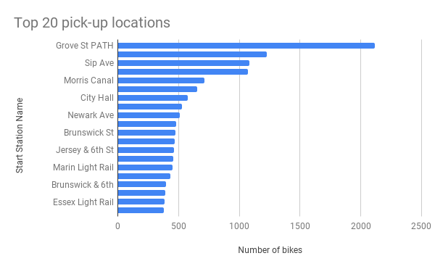
What are the most popular Citi Bike pick-up locations?

Slide 6
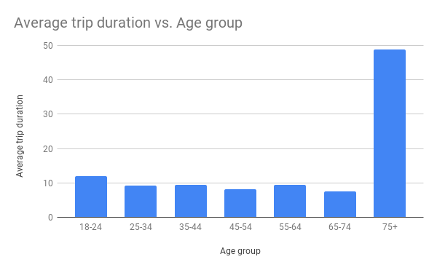
2. How does the average trip duration vary across different age groups?
75+ customers take
the longest trips on
average

Slide 7
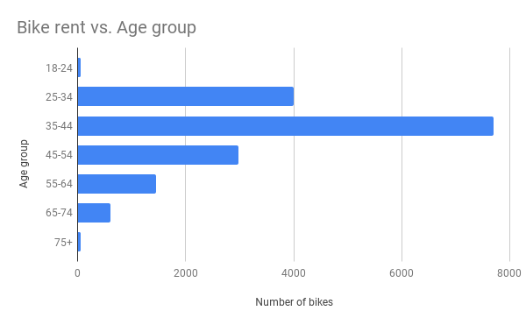
3. Which age group rents the most bikes?
The age group 35-44
Rents the most

Slide 8
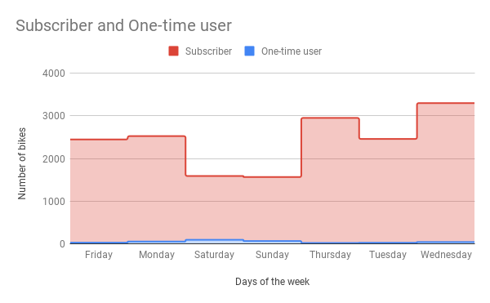
4. How does bike rental vary across the two user groups (one-time users vs long-term subscribers) on different days of the week?
Subscribers dominate
the weekdays while
there is a surge of
casual users in the
weekends

Slide 9
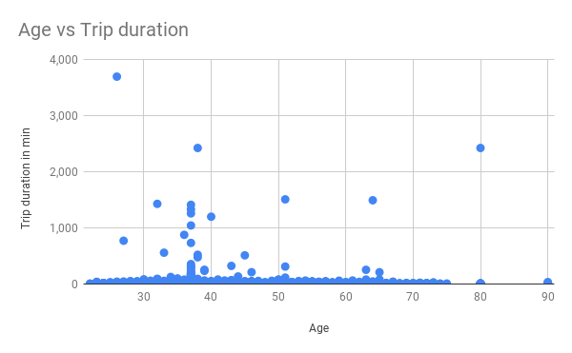
5. Do factors like weather and age impact bike trip duration?
No clear relation
between user age
and bike trip duration
has been found

Slide 10
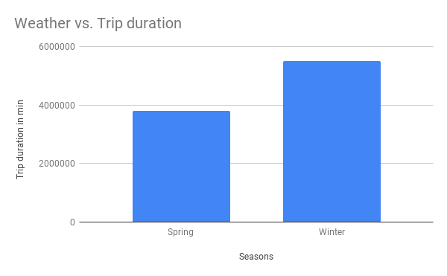
Cont.
When can see from the
chart that there is higher
trip duration during
cold weather

Slide 11
Summary

Slide 12
Summary of findings:
Top 5 pick-up locations for bikes:
Grove St Path, Exchange Place, Sip Ave, Hamilton Park, & Morris Canal
Customer base:
Most of the customer are between the ages 25-54 and are long-term subscribers
Citi Bike customer behavior:
75+ customers take the longest trips on average while 65-74 take shortest

Slide 13
Actions & Recommendations

Slide 14
Recommended actions:
Product recommendations:
Install more bikes at Grove St Path, Exchange Place, Sip Ave, Hamilton Park, & Morris Canal.
Marketing recommendations:
The Citi Bike customer base is mostly long-term subscribers aged between 25-64, who are most active on weekdays. This tells us that they are probably people who live in New York and use Citi Bikes to commute. Marketing and advertising campaigns should therefore target this particular demographic.

Slide 15
Thank you!

